Slide 1
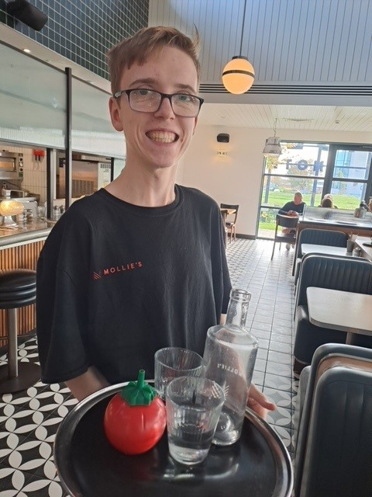
My Journey
From College to Pay Slip
Max Mulligan

Slide 2
About Me
Autism and Global Delay, with Social Communication disorder
Take longer to learn new skills, with problems retaining information.
Benefit from repetition and creative learning methods such as one to one instruction
Skills I have:
Caring Trusting
Committed Warmth
100% reliable Team Player
Punctual Keen

Slide 3
Hobbies
My interests are​:
Drama ​
Music ( I attend a choir and enjoy attending festivals)​
Watch tv particularly F1 and other sports. I enjoyed the Olympics and Euros

Slide 4
Project Pilot
Learned about the scheme through social media
Asked college to make further enquiries on my behalf
Attended an interview in the Galleries
I was very nervous as this was my first proper interview with people I didn't know. Dad made me wear a suit! Only time I have worn a suit is to prom and a wedding.
The interview was both task based and written. Was anxious to find out if I was successful.
I attend classroom-based learning with other interns. These have become friends.
The learning has been around skills associated with entering the job market such as applications and cover letters.
Fantastic support from Project Pilot Staff

Slide 5
My First Placement – Mollies Diner
Mollies is an American style Diner and Motel situated at Cribbs Causeway.
I have to travel on two buses to get to the placement each day
Was very nervous on my first day but Liam was incredibly helpful in my learning and training
Became more confident after my training and when I started work in the Diner
My job coach has helped me to learn hospitality skills and created a table layout plan to remind me where everything goes
Staff help me to learn from my mistakes. Very encouraging!
All the staff are friendly and involve me in their conversations
The customers are also nice, I even got a tip!

Slide 6
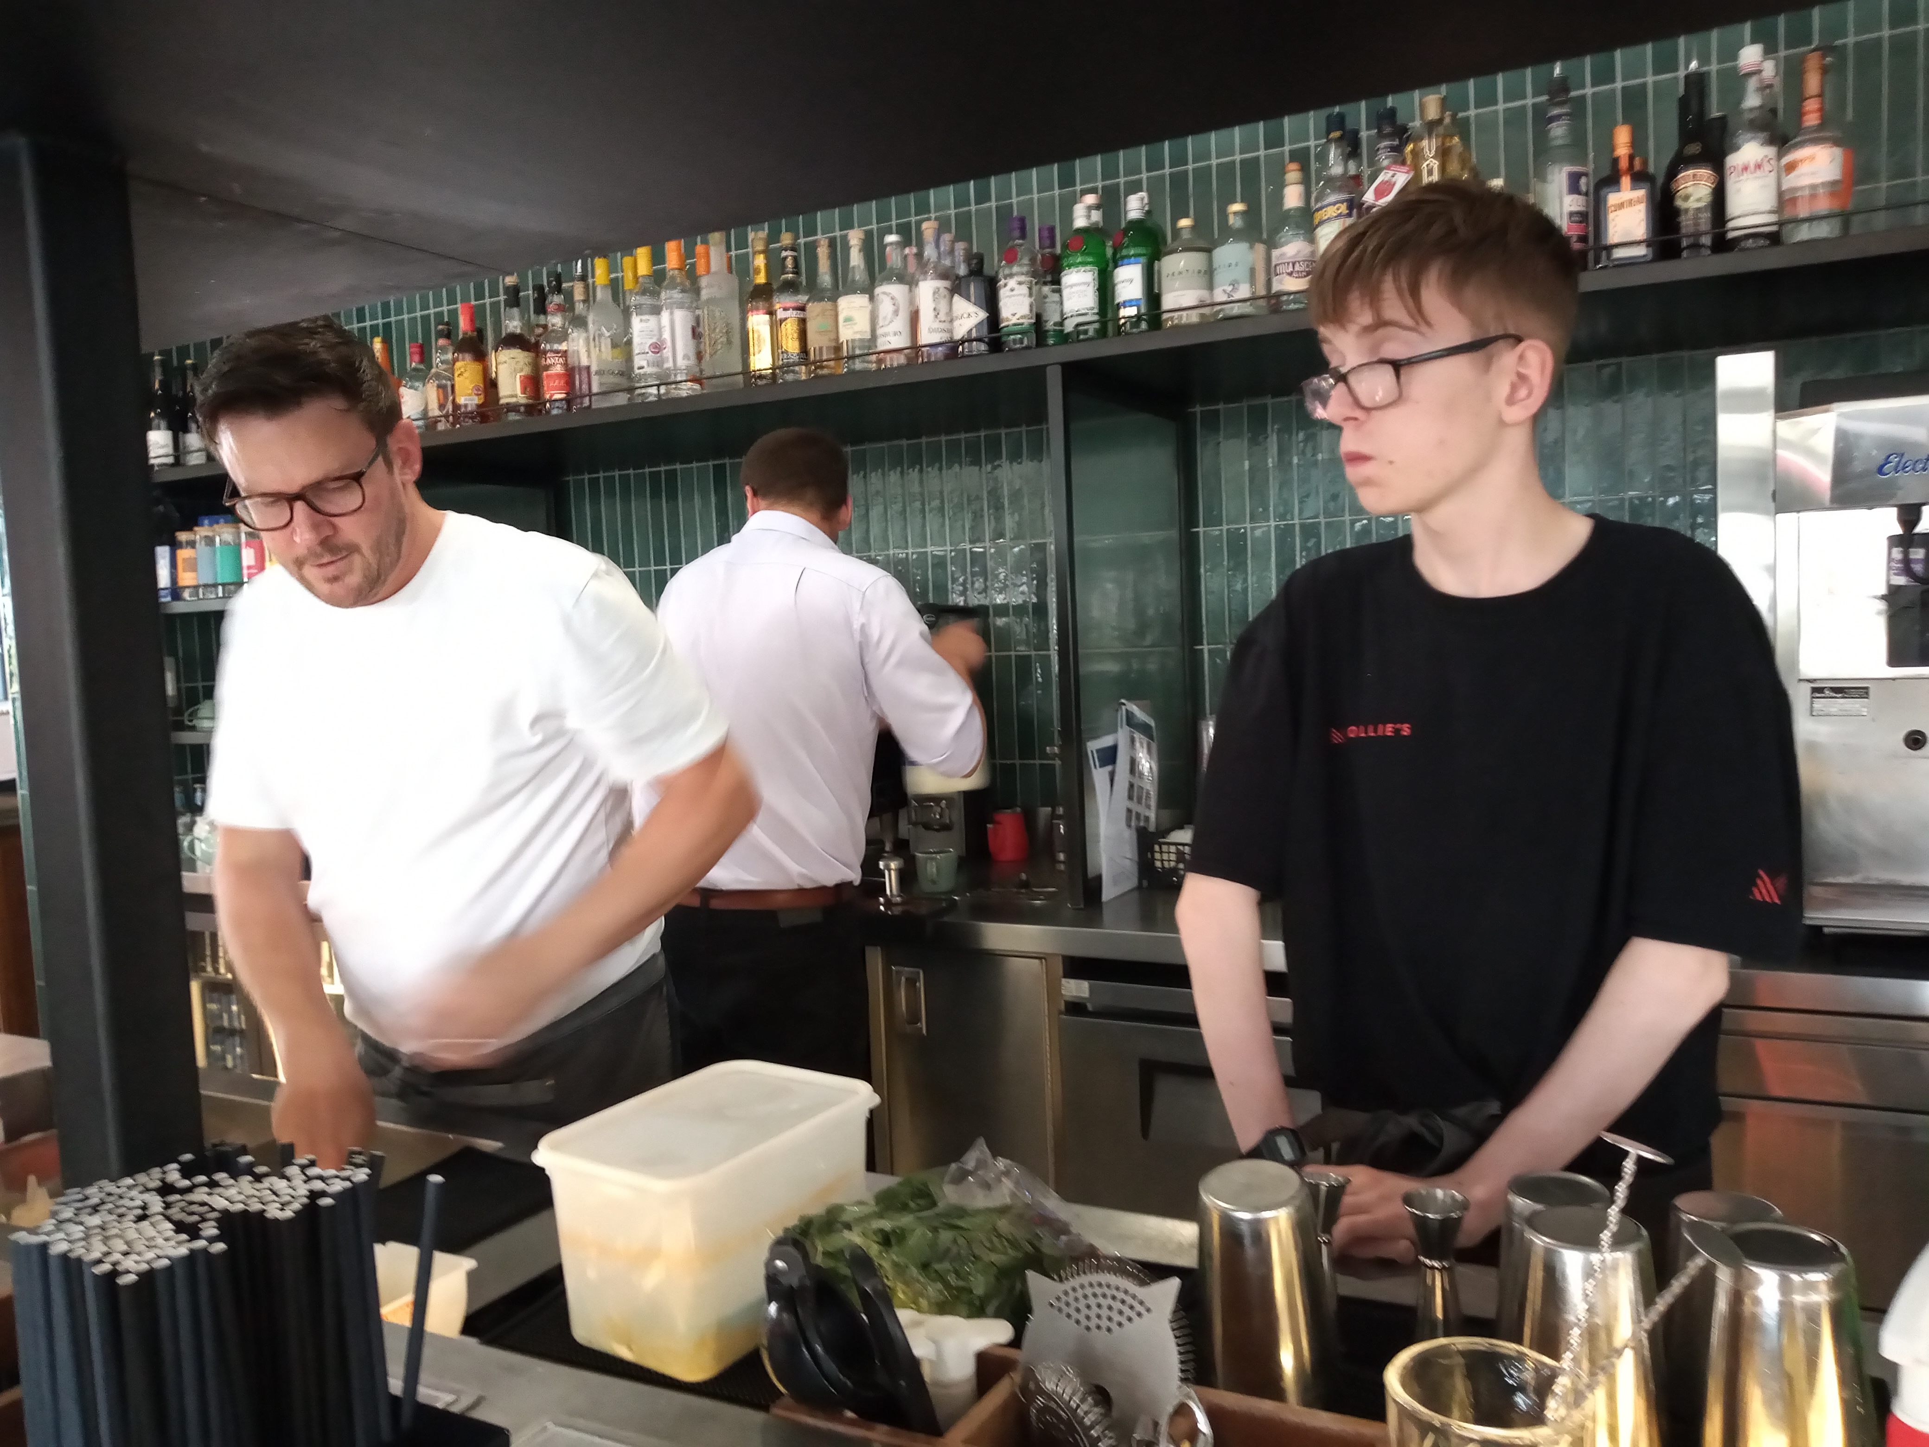
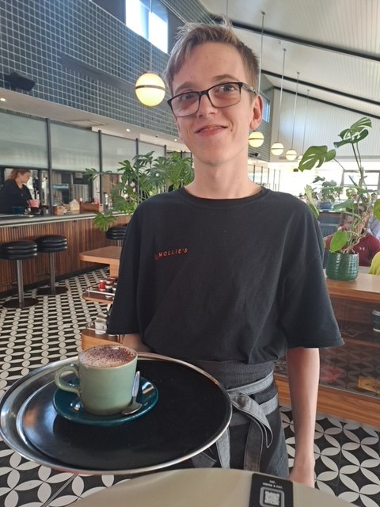
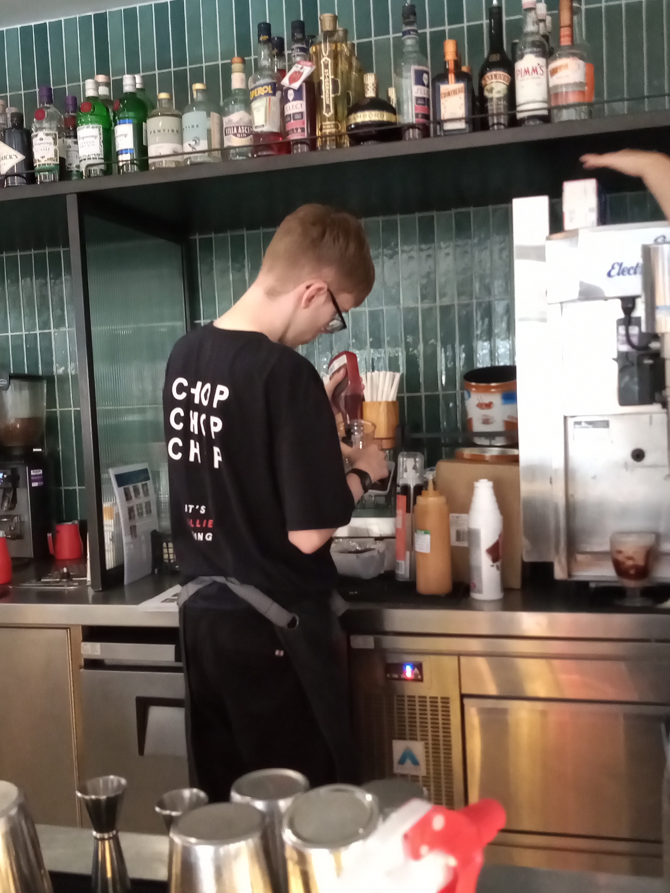
Photos from mollies

Slide 7
Hopes And Dreams
What would I like to happen next?
Now I have a job at Mollies, I want to continue to make progress learning new skills and working in different areas to make me more valuable to the company
What would I like to be doing in 3 years time ?
Well, they are currently advertising for a General Manager, so maybe I might slip an application in.

Slide 8
